Slide 1
Adversarial Search
Instructor: Zainab Yousuf

Slide 2
Content
Adversarial Environment
Adversarial Search
Minimax Procedure

Slide 3
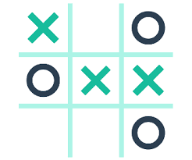
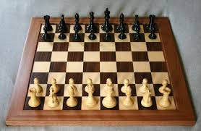
Adversarial Search
“Adversarial search is a type of search in which two or more than two agents search the searching space with contrary goals”
Such scenarios usually occur in games, where two opponents also called adversaries look for opposite goals.
For example,
Tic-tac-toe game
Chess

Slide 4
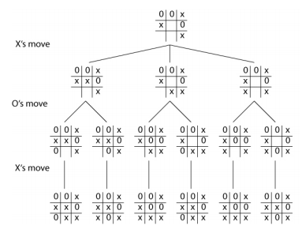
Tic-tac-toe as adversarial search
In Tic-tac-toe, one player might want to complete a line with crosses while at the same time second player wants to complete a line of zeros. Hence both have different goals.

Slide 5
Tic-tac-toe as adversarial search
Further, if player one puts a cross in any box, player-two will intelligently try to make a move that would leave player-one with minimum chance to win, that is, he will try to stop player one from completing a line of crosses and at the same time will try to complete his line of zeros

Slide 6
Look-ahead strategy in multiplayer games
In adversarial searches one player tries to cater for the opponent’s moves by intelligently deciding that what will be the impact of his own move on the overall configuration of the game.
what would be the impact of his/her move
what options will be open to the opponent once he has made this move.
What will the game situation after few turns?
This Intelligent behavior is refer as look-ahead strategy.
In AI this look-ahead strategy is implemented using Minimax Procedure.

Slide 7
Minimax Procedure
The opponents in a game are referred to as MIN and MAX.
MAX represents the player trying to win, or to MAXimize his/her advantage.
MIN is the opponent who attempts to MINImize MAX’s score.
Minimax procedure assumes that both players play optimally
The maximizer has to keep in view that what choices will be available to the minimizer on the next step.
The minimizer has to keep in view that what choices will be available to the maximizer on the next step

Slide 8
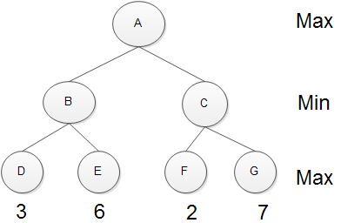
Minimax Procedure (cont…)
Example:
Looking at the heuristic value at terminal nodes, the favorable choice from A is seems to be C (because it may give 7 winning chances on Max’s next move), but as both players are assumed to play optimally so, MIN node will lead the Max towards the lower value. It means that Min on his turn will pick F and left the Max with the lowest winning chances i.e. 2.
On the other hand, If A picks B, then Min by playing optimally will lead Max to D (3) which is better than F whose heuristic is 2.
By having this look ahead, A should pick B as compare to C.
How to teach this intelligent behavior to A ? (Answer: by moving this heuristic information upward).

Slide 9
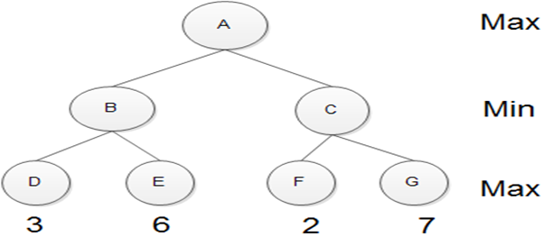
Minimax Procedure
Rules to move heuristic upward level-by-level
If the parent state is a MAX node, give it the maximum value among its immediate children
If the parent is a MIN node, give it the minimum value of its immediate children.
3
3
2

Slide 10
Example Minimax Procedure

Slide 11

“NIM” (a two-player game)
To play nim, a number of tokens are placed on a table between the two opponents; at each move, the player must divide a pile of tokens into two nonempty piles of different sizes.
7 tokens can be divided into piles of (5-2) or (4-3) and (6-1).
6 tokens can be divided into piles of (4-2) or (5-1) but not in (3-3).
The player who can no longer make a move loses the game.

Slide 12









Nim’s Search Space

Slide 13
Nim’s Search Space
1
Min
Assign Min-Max labels to each level
Decide the cost at terminal nodes
Assumption is we are looking w.r.t Max
When it’s a Win of Max we are assigning 1
When it’s a lose of Max we are assigning 0
Now move this heuristic upwards using minimax rules
1
1
1
Max
0
1
0
1
Min
0
1
0
Max
0
1
Min
0
Max

Slide 14
Nim’s Search Space
1
Min
If Min picks (5-2) then best option for Max is (4-2-1)
Because after that, Min can only pick (3-2-1-1)
Then Max will pick (2-2-1-1-1) and will lead Min to lose because Min cannot further divide
1
1
1
Max
0
1
0
1
Min
0
1
0
Max
0
1
Min
0
Max

Slide 15
Nim’s Search Space
1
Min
If Min picks (6-1) then best option for Max is (4-2-1)
Because after that, Min can only pick (3-2-1-1)
Then Max will pick (2-2-1-1-1) and will lead Min to lose because Min cannot further divide
1
1
1
Max
0
1
0
1
Min
0
1
0
Max
0
1
Min
0
Max

Slide 16
Nim’s Search Space
1
Min
If Min picks (4-3) then best option for Max is (3-3-1)
Because after that, Min can only pick (3-2-1-1)
Then Max will pick (2-2-1-1-1) and will lead Min to lose because Min cannot further divide
1
1
1
Max
0
1
0
1
Min
0
1
0
Max
0
1
Min
0
Max

Slide 17
Nim’s Search Space
1
Min
What if Max does not follow the guided path then:
If Min picks (5-2) and by violating heuristic Max picks (3-2-2)
After that, Min can only pick (2-2-2-1)
Now, Max will lose because Max cannot further divide
1
1
1
Max
0
1
0
1
Min
0
1
0
Max
0
1
Min
0
Max

Slide 18
Alpha-Beta Pruning

Slide 19
Alpha-Beta Pruning
Alpha-beta pruning is a procedure to avoid moving up all the heuristic values for all the branches of a tree, by incorporating intelligent behavior.
Alpha-beta search proceeds in a depth- first fashion.
Two values, called alpha and beta, are created during the search.
The alpha value is associated with MAX nodes that can never decreases
The beta value is associated with MIN nodes that can never increase.
Suppose a MAX node’s alpha value is 6. Then MAX need not to consider any value less than or equal to 6 from its immediate children (Min nodes).
Similarly, if MIN has a beta value of 6, it need not to consider value of 6 or more from its immediate children (Max nodes)

Slide 20
Alpha-Beta Pruning (Continue)
Two rules for terminating search, based on alpha and beta values, are;
Search can be stopped below any MIN node having a beta value less than or equal to the alpha value of any of its MAX ancestors.
Search can be stopped below any MAX node having an alpha value greater than or equal to the beta value of any of its MIN node ancestors.

Slide 21
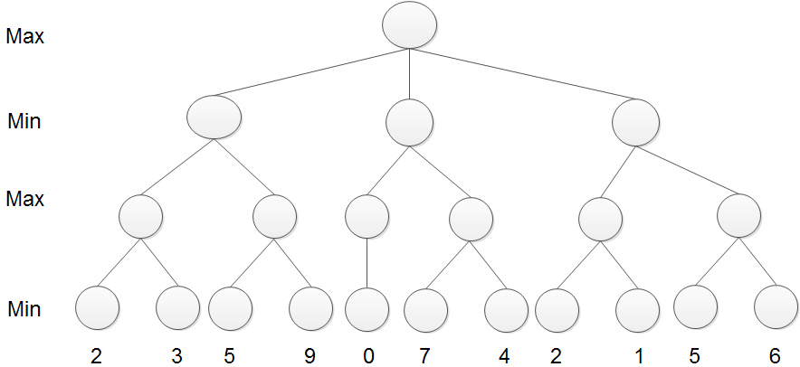
Alpha-Beta Pruning (Continue)

Slide 22
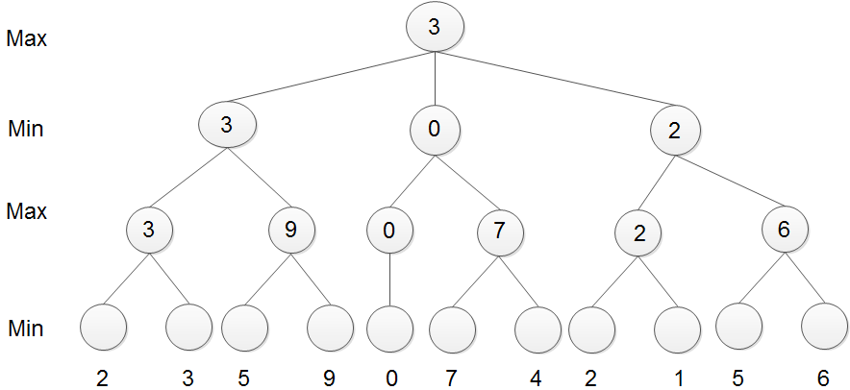
Simple Minimax Procedure

Slide 23
Alpha-Beta Pruning (Continue)
α >2

Slide 24
Alpha-Beta Pruning (Continue)
3
α >2

Slide 25
Alpha-Beta Pruning (Continue)
β <3
α>3

Slide 26
Alpha-Beta Pruning (Continue)
According to Max nature this 5 should be replace with 9. but any value greater than r equal to 3 cannot be shifted upwards because the upper node is expecting value less than 3. therefore we don’t need to consider the branch with value 9. We can prune it
Search can be stopped below any MAX node having an alpha value greater than or equal to the beta value of any of its MIN node ancestors.
β <3
α>3
α>5

Slide 27
Alpha-Beta Pruning (Continue)
α>3
β <3
α>3
α>5

Slide 28
Alpha-Beta Pruning (Continue)
α>3
β <3
α>0
α>3
α>5

Slide 29
Alpha-Beta Pruning (Continue)
According to Min nature, node’s value can be replaced only with a value less than zero that may be found on right branch but such a value can never be move upward because the upper node is expecting value greater than 3. Therefore we don’t need to consider the right branch of β <0
Search can be stopped below any MIN node having a beta value less than or equal to the alpha value of any of its MAX ancestors.
α>3
β <3
β <0
α>0
α>3
α>5

Slide 30
Alpha-Beta Pruning (Continue)
α>3
β <3
β <0
α>0
α>2
α>3
α>5

Slide 31
Alpha-Beta Pruning (Continue)
Search can be stopped below any MIN node having a beta value less than or equal to the alpha value of any of its MAX ancestors.
α>3
β <3
β <0
β <2
α>0
α>2
α>3
α>5

Slide 32
Alpha-Beta Pruning (Continue)
Min
Max
Min
Max

Slide 33
For Practice of Alpha beta Pruning

Slide 34
Thank You

